Slide 1

CS 533 INTRO TO DATA SCIENCE
Michael Ekstrand

Slide 2
COMPARING DISTRIBUTIONS

Slide 3

Learning Outcomes
Draw a Q-Q plot to compare two distributions
Assess distribution fit with a Q-Q plot
Photo by Wesley Tingey on Unsplash

Slide 4
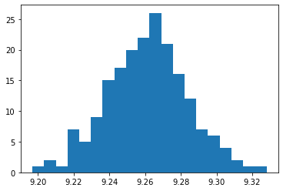
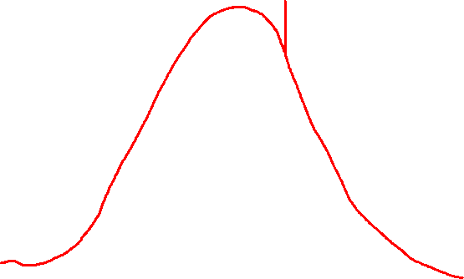
Distribution
Normal?

Slide 5
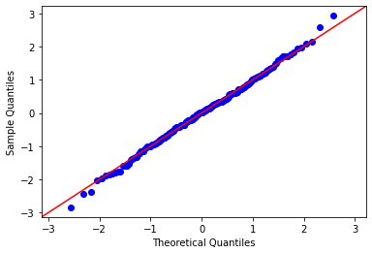
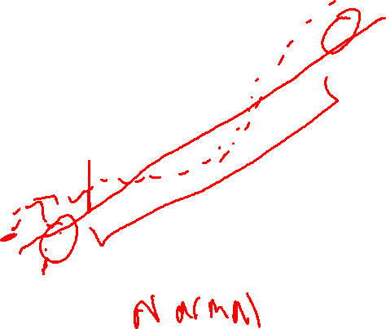
The Q-Q Plot
Points: quantiles
Y-axis: quantile in data
X-axis: quantile from distribution
Straight line indicates match
X can be:
Values from a theoretical
2nd data set

Slide 6
Plotting
Statsmodels: qqplot
line=45 shows ‘match’ line
fit=True aligns data to work w/ line
Notebook demonstrates
Also shows how to build your own
Don’t do that

Slide 7
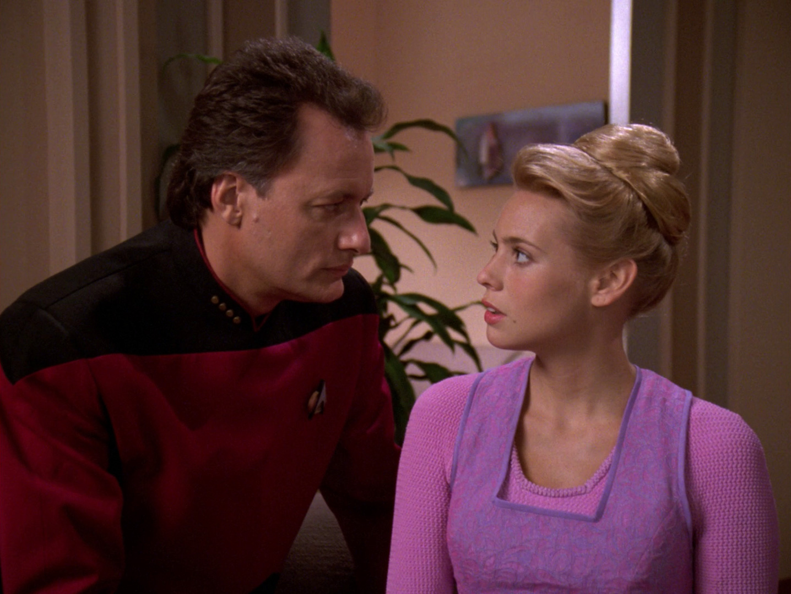
Wrapping Up
Q-Q plots let us compare data against a distribution (or other data)
Data is on a straight line when the distribution matches.

